Slide 1
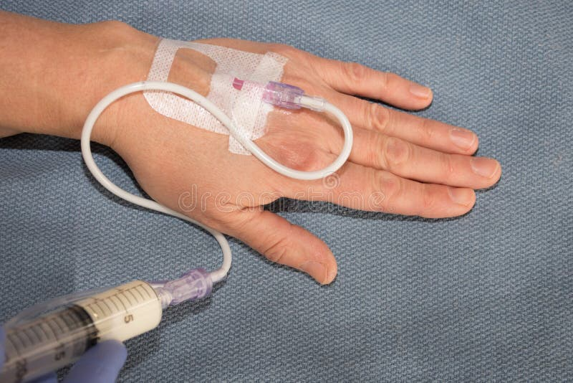
Intravenous Anesthetic agents (IVAA)
Mulualem Sitot (BSc, MSc in ACA)
Department of Anesthesia
Addis Ababa University

Slide 2
Intravenous Anesthetic agents (IVAA)
Propofol
Ketamine
Barbiturates
Etomidate
Benzodiazepines
Notes:
The specialty of anesthesia began in the mid nineteenth century and became firmly established less than six decades ago.
Ancient civilizations had used opium poppy, coca leaves, mandrake root, alcohol, and even phlebotomy (to the point of unconsciousness)
to allow surgeons to operate.

Slide 3
Outline
Objectives
Introduction
Mechanisms of action
Pharmacokinetics and pharmacodynamics
Clinical uses
Side effects

Slide 4
Objectives
At the end of this session, you will be able to:
describe the ideal properties of IVAA
describe the pharmacokinetics and pharmacodynamics of different classes of IVAA.
State the different systemic effects of commonly used IVAA
Outline the indications, contraindications & adverse effects of commonly used IVAA
Outline the right dose, route & concentration of commonly used IVAA

Slide 5
Introduction
The first attempt at producing insensibility by means of intravenous (IV) injection was done in 1656 by Injection of tincture of opium into the vein of a dog.
It was not until the introduction of thiopentone by Lundy and Waters in 1934,
that the IV method began to achieve popularity.
General anesthesia is not limited to the use of inhalation agents
Induction of anesthesia in adult patients usually involves IV administration.
Notes:
In Boston, on October 16, 1846, William T.G. Morton conducted the first publicized demonstration of general anesthesia
for surgical operation using ether.

Slide 6
Cont.….
The introduction of thiopental into clinical practice in 1934
marked the beginning of modern IV anesthesia.
Today, IV anesthetics are used
for induction and maintenance of anesthesia and
sedation in a wide variety of circumstances.

Slide 7
Properties of Ideal IV Anaesthetics
Rapid onset:
It is achieved by an agent which is mainly un-ionized at blood PH
IV anesthetics have a rapid onset after administration.
rapidly distribute to higher perfused and vessel-rich tissues.
Their lipophilicity allows for rapid crossing of the blood–brain barrier.
Rapid recovery:
Early recovery of consciousness is produced by
rapid redistribution of the drug from brain into other well perfused tissues.

Slide 8
Properties…
Analgesia at sub-anaesthetic concentrations
Minimal CVS & respiratory depression
No emetic effects
No excitatory phenomena
(e.g. coughing, hiccup, on induction )
No emergence phenomena (e.g. Nightmares)
No interaction with NMB drugs

Slide 9
Properties…
Drug compatibility (water-solubility) and stability in solution.
Lack of pain on injection, veno-irritation, and local tissue damage following extravasation.
Low potential to release histamine or precipitate hypersensitivity reactions.
Rapid and smooth onset of hypnotic action without excitatory activity.
Rapid metabolism to pharmacologically inactive metabolites.
Notes:
Biotransformation
It is the chemical process by which the drug molecule is altered in the body.
It is the alteration of a substance by metabolic processes

Slide 10
Properties…
↓ in cerebral metabolism and intracranial pressure.
Rapid and smooth return of consciousness and cognitive skills with residual analgesia.
Absence of postoperative nausea and vomiting, amnesia, psychomimetic reactions, dizziness, headache, or prolonged sedation (hangover effects).
However, the “ideal” IV anesthetic is yet to be developed

Slide 11
Properties of the Ideal IV Anesthetic Agent
Pharmacodynamic/Pharmacokinetic Properties
Hypnosis and amnesia
Rapid onset (time of one arm-brain circulation)
Rapid metabolism to inactive metabolites
Minimal cardiovascular and respiratory depression
No histamine release or hypersensitivity reactions
Nontoxic, nonmutagenic, noncarcinogenic
No untoward neurological effects, such as seizures, myoclonus, antanalgesia, neurotoxicity
Other beneficial effects: analgesia, antiemetic, neuroprotection, cardio-protection
Pharmacokinetic-based models to guide accurate dosing
Ability to continuously monitor delivery
Physiochemical Properties
Water-soluble
Stable formulation, nonpyrogenic
Nonirritating: painless on intravenous injection
Small volume needed for induction
Inexpensive to prepare and formulate
Antimicrobial preparation
N.B. No single anesthetic agent is perfect

Slide 12
Uses of intravenous Anaesthetics
Induction of anaesthesia - a single injection to induce anaesthesia
To supplement inhalation agents - used to supplement low potency inhalational agents
Total intravenous Anaesthesia (TIVA)
To produce sedation - in intensive care units, regional anaesthesia.
To control convulsions

Slide 13
General Pharmacology of IV Hypnotics
Mechanism of Action
A widely accepted theory:
both IV and IAA exert their sedative and hypnotic effects through
an interaction with the inhibitory γ-aminobutyric acid (GABA) neurotransmitter system.
When the GABA_{A} receptor is activated, ⇒ transmembrane chloride conductance increases ⇒ resulting in hyperpolarization of the postsynaptic cell membrane and functional inhibition of the postsynaptic neuron.
Notes:
GABA is the principal inhibitory neurotransmitter within the CNS.

Slide 14
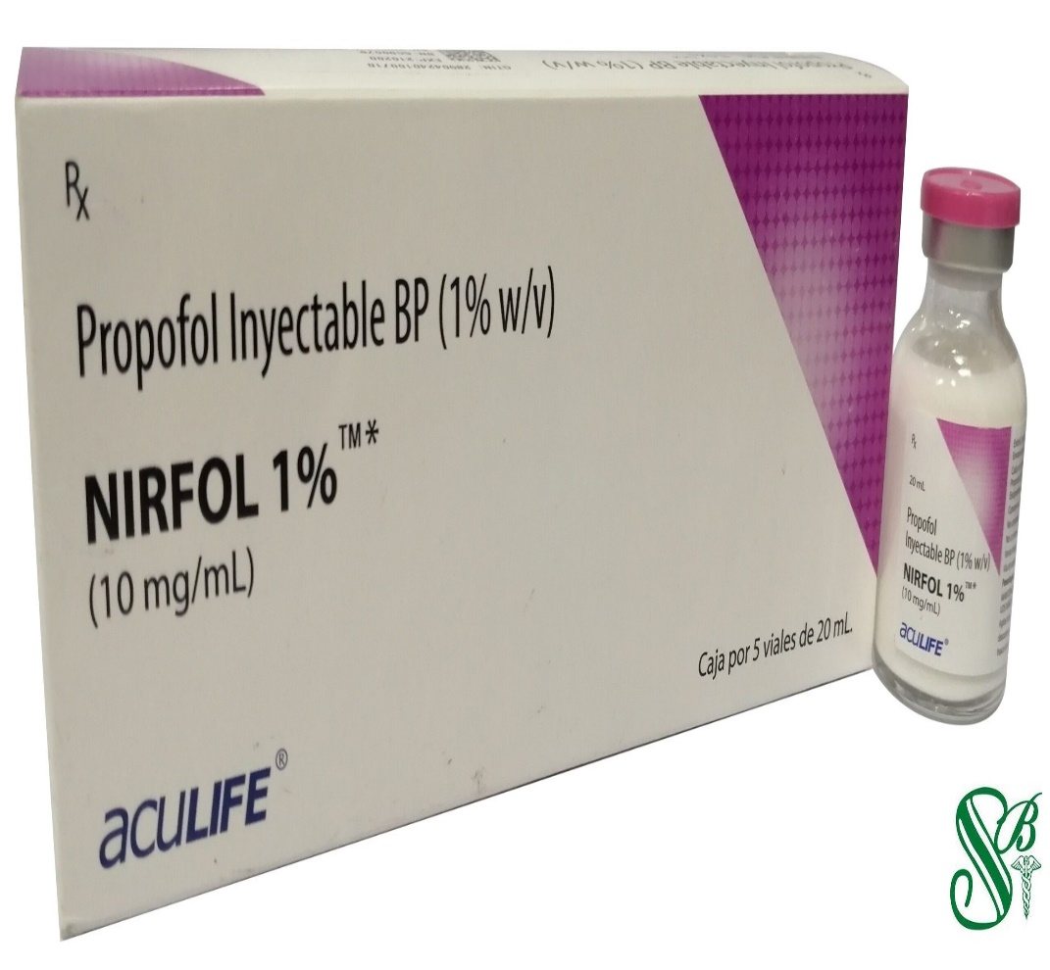
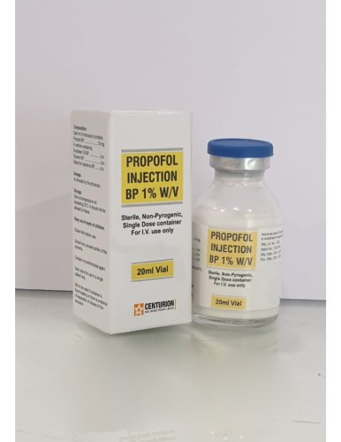
Propofol

Slide 15
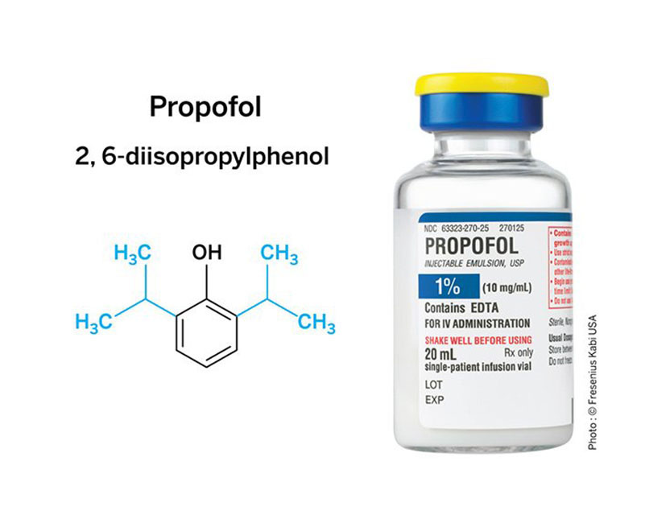
Propofol
Propofol consists of a phenol ring substituted with two isopropyl groups (see the figure).
It is the most frequently used IV hypnotic today.

Slide 16
Propofol…
Appearance: milky white, slightly viscous
Relatively insoluble in aqueous solutions
May be diluted with 5% dextrose in water
Concentration= 1% or 10 mg/mL; PH =7
Properties: hypnosis, amnesia
Stable at room temperature
Not light sensitive
Unconsciousness in ~ 45 seconds and lasts ~15 minutes.

Slide 17
Propofol
Introduced in the 1970s,
it was rapidly withdrawn from the market due to concern for anaphylactic reactions
Nearly a decade later, it was reintroduced in its more current form consisting of
1% propofol, 10% soybean oil,
2.25% glycerol as a tonicity-adjusting agent, and
1.2% egg phospholipid emulsifier(egg lecithin)….concerns regarding microbial growth in the emulsion
Remedy: In the 1990s, ethylene diamene tetraacetic acid (EDTA) was added to this formulation
To deter (prevent) microbial growth within the emulsion
Notes:
Following concerns regarding microbial growth in the emulsion, EDTA was added for its bacteriostatic activities.
The lipid emulsion comes in a familiar milky white consistency, and can be stored at room temperature without any significant degradation

Slide 18
Propofol…
It has become the new “gold standard” in anesthesia practice with
a rapid onset, rapid recovery after bolus administration from redistribution, and its utility as a continuous infusion.
It is unique with patients awake and oriented after administration
with lack of “hangover” effect that was associated with older anesthetics.

Slide 19
Mechanisms of Action
How is the unconscious state attained by propofol?
It is complicated and not fully understood
Primarily, it occurs via enhancement of gamma-aminobutyric acid-A (GABA-A) inhibitory pathways.
i.e., enhancement of gamma-aminobutyric acid (GABA)-induced chloride currents.
Notes:
The mechanism by which the unconscious state is attained by propofol is complicated, but primarily occurs via enhancement
of gamma-aminobutyric acid (GABA) inhibitory pathways.

Slide 20
Mechanisms of Action
The mechanism by which propofol induces a state of general anesthesia involve
facilitation of inhibitory neurotransmission mediated by GABA →
allosterically increases binding affinity of GABA for the GABA A receptor →
This receptor is coupled to a chloride channel → and activation of the receptor leads to hyperpolarization of the nerve membrane.

Slide 21
Pharmacokinetics of propofol
Absorption
Propofol is available only for intravenous administration
for the induction of GA and for moderate to deep sedation
Distribution
Propofol has a rapid onset of action.
Awakening from a single bolus dose is also rapid due to a very
short initial distribution half-life (2–8 min)
More rapid recovery and less “hangover” than other induction agents
This makes it a good agent for outpatient anesthesia.
Notes:
A smaller induction dose is recommended in elderly patients because of their smaller V d .
Age is also a key factor determining required propofol infusion rates for TIVA

Slide 22
Cont.….
Biotransformation
Rapidly metabolized in the liver to its inactive and water-soluble metabolites which are is excreted by the kidneys
Can undergo extrahepatic metabolism (kidneys and lungs ~ 30%).
Thus, clearance of propofol exceeds hepatic blood flow
High plasma clearance rate—
explains the more complete recovery when compared with thiopental (no “hang-over”)
Wake-up after induction dose is mainly due to redistribution, which occurs in 8-10 min.
Notes:
The clearance of propofol exceeds hepatic blood flow, implying the existence of extrahepatic metabolism.
This exceptionally high clearance rate probably contributes to relatively rapid recovery after continuous infusions.

Slide 23
Cont.….
The pharmacokinetics of propofol do not appear to be affected by obesity, cirrhosis, or kidney failure.
Excretion
Although metabolites of propofol are primarily excreted in the urine,
chronic kidney failure does not affect clearance of the parent drug.
Less than 1% propofol is excreted unchanged (unmetabolized) in urine, and
only 2% is excreted in feces.
Notes:
The most common extrahepatic sites of metabolism are the kidneys and lungs, both responsible for up to 30% of the common propofol metabolites,
explaining why pharmacokinetics of propofol are relatively consistent across patient populations with different comorbid states.

Slide 24
Cont.…
Pharmacodynamics of propofol
CNS effects
Hypnosis but no analgesia
Decreased cerebral blood blow (CBF) and cerebral metabolic rate for oxygen (CMRO2).
causing a decreased ICP
Occasional excitatory effects seen, such as twitching “this is not a seizure”
Neuroprotective
Lowers CMRO2 and decreases ICP primarily by lowering CBF.
Notes:
Propofol has specific antioxidant properties, and its function as a free radical scavenger has been hypothesized to play a role in preventing
injury during neurodegenerative processes such as stroke and trauma.

Slide 25
Cont.….
Has antioxidant properties,
and its function as a free radical scavenger
Anti-convulsant
The anesthetic of choice during induction of anesthesia for electroconvulsive therapy (ECT) because it shortens seizure duration
Attenuation of excitotoxic glutamate pathways
that lower the likelihood of programmed neuronal apoptosis
Anti-inflammatory effects (e.g., decreasing TNF-alpha)
Notes:
Propofol induction profoundly decreases arterial pressure by decreasing peripheral vascular resistance and myocardial contractility
Propofol also decreases patient’s heart rate (HR) secondary to its vagotonic effect.

Slide 26
Cont.…
CVS effects
It has the most profound effect on blood pressure
compared with similar doses of other IV anesthetics
Depresses baroreceptor reflex
↓SBP and DBP without the expected increase in HR due to a drop in
systemic vascular resistance (inhibition of sympathetic vasoconstrictor activity), preload, and cardiac contractility.
Profound indirect arterial vasodilation and venodilation + direct myocardial depression
both arterial and venous, causing drops in preload and afterload
decrease in cardiac output, stroke volume, and systemic vascular resistance (SVR).
Must be careful with elderly and hypovolemic patients
Notes:
The hemodynamic effects of propofol are dose dependent and more significant after an induction dose than during a continuous infusion.
Propofol decreases sympathetic activity and leads to indirect arterial vasodilation and venodilation.
The observed blood pressure drop results from a decrease in cardiac output, stroke volume, and systemic vascular resistance (SVR).

Slide 27
Cont.…
Respiratory effects
Potent respiratory depressant (dose dependent)
Usually produces apnea with higher induction dose
A typical maintenance dose results in diminished tidal volumes and increased respiratory rate
Inhibits ventilatory response to hypoxia and hypercapnia
Great reduction in upper airway reflexes
Notes:
Factors associated with propofol-induced hypotension include large doses, rapid injection, and old age.
Propofol markedly impairs the normal arterial baroreflex response to hypotension

Slide 28
Cont.…
Good for asthmatics and for insertion of LMA
Can sometimes intubate without muscle relaxant
Must be ready to “control the airway” once given even in small doses.
Potent bronchodilator,
Primarily because of its direct effects on intracellular calcium homeostasis.

Slide 29
Pharmacodynamics…
Other: antiemetic effect
used for post-operative nausea and vomiting: can be given in 10-20 mg doses

Slide 30
Clinical Uses of Propofol
Induction of general anesthesia, including rapid sequence Induction
Maintenance of anesthesia
either with volatile anesthetics or
as a sole anesthetic agent in total intravenous anesthesia (TIVA)
Sedation in the ICU
Monitored anesthesia care (MAC) sedation for minor procedures
Sedation for procedure under regional block or local infiltration

Slide 31
Cont.…
Uses and Doses of Intravenous Propofol
Clinical uses | Dose
Induction of general anesthesia | 1-2.5 mg/kg IV
Maintenance of general anesthesia | 100 - 200 mcg/kg/min IV infusion
Sedation in the ICU, minor procedures… | 25 to 75 mcg/kg/min IV infusion
Antiemetic action | 10-20 mg IV, can repeat every 5-10 min or start infusion of 10 μg/kg/min
Notes:
Induction dose requirement variability is tremendous among patients with different characteristics and comorbidities.
Elderly patients typically have prolonged effects and increased sensitivity to propofol because of decreased cardiac output and clearance.
On the opposite end of the spectrum, children typically have a larger than average volume of distribution and quicker clearance, resulting in increased propofol
requirement on a per-kilogram basis.
Morbidly obese patients should have lean body weight used when calculating propofol dosing
Patients with chronic alcohol abuse, as expected, have an increased induction dose requirement.
An exaggerated hemodynamic response is likely after induction of propofol in patients with cardiovascular disease.
Thus, determination of the appropriate propofol induction dose requires careful assessment of premedication administration, patient history, and comorbidity.

Slide 32
Advantages of propofol
Rapid and smooth induction and emergence from anesthesia
Quick offset - quicker than thiopental, even if repeated or continuous infusion.
Good for bronchospasm vs. thiopental
↓ ICP (neuroprotective)
↓es nausea and vomiting vs. thiopental and Etomidate
Can be used as a maintenance anesthetic
No adrenal suppression vs. Etomidate
Can sometimes intubate without muscle relaxant
thereby eliminating risks of suxamethonium or NMB; no need to “reverse”; patient may occasionally breathe spontaneously during case
Notes:
The rapid and smooth induction and emergence from anesthesia helped transform propofol into an intravenous
sedative–hypnotic that is a viable alternative to standard inhalational agents and other intravenous drugs.

Slide 33
Cont.….
Side effects of propofol
Pain on injection (60-70% of patients)
How to intervene this S/E?
Remedy:
Pretreatment with opioids prior to induction with propofol
Pretreatment with a local anesthetic such as lidocaine in conjunction with venous occlusion using a tourniquet,
Addition of Lidocaine with propofol (2 mL of 1% IV lidocaine in 18 mL propofol).
Pretreatment with nonsteroidal anti-inflammatory drugs (NSAIDs), ketamine, steroids, and beta-blockers (limited success).
Using the large antecubital vein as an alternative to smaller peripheral vein sites
Expensive???

Slide 34
Cont.….
Supports bacterial growth
Remedy:
Sterile technique must be observed in preparation and handling.
Propofol should be administered within 6 h of opening the vial.
Hypotension
↓es blood pressure to a greater degree than Etomidate and Thiopental
Respiratory depression
No analgesia vs. ketamine
Notes:
A history of egg allergy does not necessarily contraindicate the use of propofol because most egg allergies involve
a reaction to egg white (egg albumin), whereas egg lecithin is extracted from egg yolk

Slide 35
Cont.….
Propofol infusion syndrome (PRIS)
a prolonged duration with continuous infusion
extremely rare, but potentially deadly
Cause: Use of propofol infusion for long-term sedation in the ICU (dose of 4 mg/kg/h for >48 hr.)
key clinical characteristics
unexplained metabolic acidosis, hyperkalemia,
hyperlipidemia, rhabdomyolysis, hepatomegaly, renal failure, and ECG changes, arrhythmias, and
progression to cardiac failure
Pathophysiology of PRIS???
Notes:
The pathophysiology of PRIS is not well understood, but may involve mitochondrial toxicity and uncoupling of the intracellular
respiration chain, although other hypotheses such as inhibition of fatty acid oxidation have been suggested.

Slide 36
Cont.….
Drug Interactions
Fentanyl and alfentanil concentrations may be increased with concomitant administration of propofol.
Midazolam can reduce the required propofol dose by more than 10%.

Slide 37
Summary Of propofol
Key Pharmacology | Key Clinical Uses
Predictable context-sensitive half-time (half life) across various comorbidities | General anesthesia induction and maintenance
CNS depressant, neuroprotective, anticonvulsant, decreases CMRO2, CBF, and ICP | Conscious and deep sedation, including out of-operative-room settings
Can be used for EEG burst suppression | Intensive care unit sedation
Cardiovascular: Significant decreases in SVR, SV, and cardiac output | Postoperative nausea and vomiting prophylaxis
Pulmonary: Respiratory depressant and potent bronchodilator | Safe for use in patients with malignant hyperthermia
Addiction potential: May elicit feelings of wellbeing or euphoria during emergence
Side effects: Associated pain with injection, propofol infusion syndrome

Slide 38
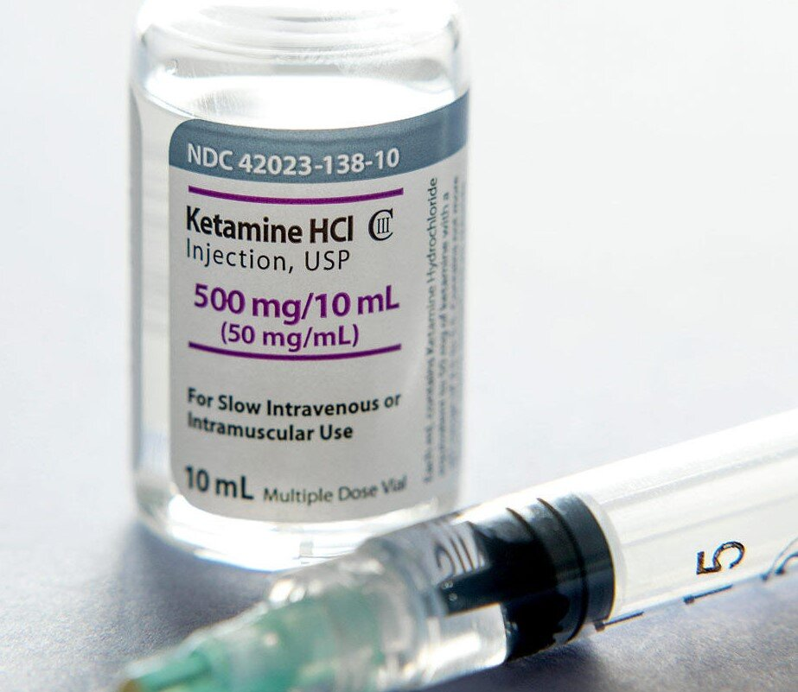
Ketamine
Ketamine comes closest to being a “complete” anesthetic as it induces
analgesia,
amnesia, and
unconsciousness.

Slide 39
Ketamine
Ketamine (Ketalar) was synthesized in 1962 by Stevens
It was first used in humans in 1965 by Corssen and Domino.
Ketamine was released for clinical use in 1970
Ketamine is a racemic mixture of the isomers R(-)-ketamine and S(+)-ketamine.
The S(+)-isomer (Ketanest) is 3 to 4 times more potent as an analgesic with a faster clearance and recovery and with fewer psychomimetic side effects.
Partially water soluble
Forms a white crystalline salt with a pKa of 7.5.
Notes:
Ketamine is an analog of phencyclidine that is a chiral compound and is a racemic mixture of S and R enantiomers.
The S(+) enantiomer of ketamine is three to four times more potent than the R enantiomer.
S enantiomer has a shorter duration of action and is cleared more rapidly

Slide 40
Cont.…
It is primarily non-competitive glutamate N-methyl-D-aspartate (NMDA) receptor antagonist.
Has analgesia effects at low doses,
mediated by antagonism on the NMDA receptors.
It’s a dissociative anesthetic agent.
by dissociative it mean that the patient is unconscious but appears awake and doesn’t feel pain.
It has anesthetic and analgesic effect
Notes:
It produces dissociative anesthesia rather than generalized depression of the CNS through antagonistic actions at the phencyclidine (PCP) site of the N-methyl-D-aspartate receptor (NMDAR)

Slide 41
Cont…
Properties
Hypnotic
Strong analgesic
Amnesic
Smooth induction but with emergence delirium.
Unpleasant dreams (Hallucination) – up to 24 hrs.
It has rapid onset and relatively rapid offset
Rapid onset: 30 to 60 seconds IV administration
Duration: 10 to 15 minutes

Slide 42
Cont.…
Key features
Marked nystagmus,
Significant analgesia, and
Unconsciousness
Notes:
It has rapid onset and relatively rapid offset, even after an infusion of several hours. I

Slide 43
Mechanisms of Action
It blocks polysynaptic reflexes in the spinal cord and inhibiting excitatory neurotransmitter effects in selected areas of the brain.
In contrast to the depression of the reticular activating system (RAS) induced by the barbiturates,
ketamine functionally "dissociates" the thalamus
which relays sensory impulses from the RAS to the cerebral cortex from the limbic cortex
Notes:
The limbic cortex is involved with the awareness of sensation

Slide 44
Cont…
Although some brain neurons are inhibited, others are tonically excited.
Clinically, this state of dissociative anesthesia causes the patient to appear conscious (e.g., eye opening, swallowing, muscle contracture)
but unable to process or respond to sensory input.
The existence of specific ketamine receptors and interactions with opioid receptors has been postulated.

Slide 45
Cont.…
Pharmacokinetics of ketamine
It is bioavailable by multiple routes of administration.
IM administration has a 93% bioavailability,
Transnasal has 25% to 50% bioavailability,
and rectal or oral administration has 16% bioavailability
IV
Absorption
It has been administered orally, nasally, rectally, subcutaneously, and epidurally,
but in usual clinical practice it is given intravenously or intramuscularly.
Peak plasma levels are usually achieved within 10–15 min after intramuscular injection.

Slide 46
Cont.…
Distribution
It is more lipid soluble and less protein bound than thiopental
These characteristics, along with ketamine-induced increase in CBF and cardiac output, lead to rapid brain uptake and subsequent redistribution (the distribution half-life is 10–15 min).
Awakening is due to redistribution from brain to peripheral compartments.

Slide 47
Cont.…
Very lipophilic and low protein binding (20%) → rapid onset
30 sec when given IV
3 – 4 min when given IM
Duration: 10 – 15 min. IV, 12 – 25 min. IM
If using as sole anesthetic, it will need to redoes or start drip.

Slide 48
Cont.…
Biotransformation
It is metabolized primarily in the liver by cytochrome P-450 enzymes (CYP 3A4 > CYP 2C9 > CYP 2B6).
It is biotransformed in the liver to several metabolites, one of which (norketamine).
The liver extensively metabolizes ketamine by demethylation to its principle metabolite norketamine.
Norketamine is biologically active but only has 20% to 30% the activity of racemic ketamine.
Norketamine is eliminated by renal excretion.
Excretion
End products of ketamine biotransformation are excreted renally.

Slide 49
Cont.….
Pharmacodynamics of ketamine
CVS
It produces indirect central sympathetic stimulation,
Which Indirectly increases BP, HR, and CO due to
central stimulation of SNS and inhibition of norepinephrine reuptake
Accompanying these changes are increases in myocardial work and pulmonary artery pressure
Thus, be cautious in patients with CAD, uncontrolled HTN, CHF, and arterial aneurysms
Less sympathetic stimulation when given with benzodiazepine
*Good for pts. in acute hypovolemic shock
Direct myocardial depression (large doses)
probably due to inhibition of calcium transients
Notes:
The direct myocardial depressant effects of large doses of ketamine, probably due to inhibition of calcium transients, are unmasked by sympathetic blockade (eg, spinal cord transection) or exhaustion of catecholamine stores (eg, severe end-stage shock).
On the other hand, ketamine’s indirect stimulatory effects may be beneficial to patients with acute shock.

Slide 50
Cont.….
Ketamine: Respiratory
Ventilatory drive is minimally affected by induction doses
upper airway reflexes remain largely intact
but partial airway obstruction may occur
Potent bronchodilator
Thus, good for asthmatics
Increased salivation
attenuated by premeds with anticholinergic agent like atropine or glycopyrrolate
Notes:
Upper airway reflexes remain largely intact, but partial airway obstruction may occur, and patients at increased risk for aspiration pneumonia (“full stomachs”) should be intubated during ketamine general anesthesia

Slide 51
Cont.….
Cerebral
Increases CMRO2, CBF and ICP.
However, can be used in pts. with space-occupying intracranial lesions in combination with BZDs.
Eyelash and corneal reflexes remain intact.
Myoclonic activity associated with subcortical electrical activity
Psychomimetic side effects during emergence and recovery less common
in children and in pts. premedicated with benzodiazepine
Notes:
The received dogma about ketamine is that it increases cerebral oxygen consumption, cerebral blood flow, and intracranial pressure.
These effects would seem to preclude its use in patients with space-occupying intracranial lesions such as occur with head trauma; however, recent publications
offer convincing evidence that when combined with a benzodiazepine (or another agent acting on the same GABA receptor system) and controlled
ventilation, but not with nitrous oxide, ketamine is not associated with increased intracranial pressure.

Slide 52
Cont…
GI
Increased salivation
Minimal anorexia, nausea & vomiting
Skeletal muscle:
increased tone, spontaneous movements
Generalized increase in skeletal muscle tone.
Increases the effects of muscle relaxants

Slide 53
Cont.…
Placenta
Crosses uterus/placenta easily and may increase uterine tone,
Does not depress fetus but uterine tone may cause distress
Eyes
Nystagmus/movements make it unsuitable for eye surgery,
increased IOP so don’t use with pts. with open globe

Slide 54
Clinical uses
Induction of anesthesia
It increases HR and blood pressure.
Therefore, it is a good choice for anesthetic induction in the hemodynamically unstable patient.
Analgesia
In the management of acute postoperative pain
It is associated with profound analgesia that occurs at subanesthetic levels.
Lowers pain scores and decrease opiate requirements in postoperative patients
Sedation
Provides sedation to burn patients during wound care.
Notes:
When intravenous access is lacking, ketamine is useful for intramuscular induction of general anesthesia in children and uncooperative adults.
Ketamine can be combined with other agents (e.g., propofol or midazolam) in small bolus doses or infusions for deep conscious sedation during nerve blocks, endoscopy, etc.
Ketamine binds preferentially to the N-methyl-D-aspartate (NMDA) receptors on inhibitory interneurons in the cortex, amygdala, and hippocampus. Unconsciousness results from an uncoordinated increase in neural activity. In the spinal cord, ketamine decreases arousal by blocking NMDA glutamate–mediated nociceptive signals from peripheral afferent neurons in the dorsal root ganglion to projecting neurons.

Slide 55
Cont.…
Notes:
Ketamine’s mechanism of action in the central nervous system. Ketamine binds preferentially to the N-methyl-D-aspartate (NMDA) receptors on inhibitory interneurons in the cortex, amygdala, and hippocampus. Unconsciousness results from an uncoordinated increase in neural activity. In the spinal cord, ketamine decreases arousal by blocking NMDA glutamate–mediated nociceptive signals from peripheral afferent neurons in the dorsal root ganglion to projecting neurons.

Slide 56
Cont.…
Chronic Pain management
prevents hyperalgesia due to its NMDA antagonism.
Depression (as anti-depressant)
it has a rapid effect on depression with decreased depression symptoms and suicidal ideation within 1 hour of administration.
Notes:
For treatment of depression, ketamine is typically infused intravenously over 40 minutes at a subanesthetic dose of 0.5 mg/kg.
The mechanism of ketamine’s antidepressant effects remains unclear. The antidepressant effects of ketamine may not be related to its NMDA
antagonism, but rather its effect on other CNS receptors (dopamine, adrenergic).

Slide 57
Cont.…
Uses and Doses of ketamine
Clinical uses | Dose
Induction of general anesthesia | 1-2 mg/kg IV 3-6 mg/kg IM
Sedation | 0.5-1mg/kg IV 2-4 mg/kg IM
Sedation infusion | 2.5–15 mcg/kg/min IV
Notes:
Induction dose requirement variability is tremendous among patients with different characteristics and comorbidities.
Elderly patients typically have prolonged effects and increased sensitivity to propofol because of decreased cardiac output and clearance.
On the opposite end of the spectrum, children typically have a larger than average volume of distribution and quicker clearance, resulting in increased propofol
requirement on a per-kilogram basis.
Morbidly obese patients should have lean body weight used when calculating propofol dosing
Patients with chronic alcohol abuse, as expected, have an increased induction dose requirement.
An exaggerated hemodynamic response is likely after induction of propofol in patients with cardiovascular disease.
Thus, determination of the appropriate propofol induction dose requires careful assessment of premedication administration, patient history, and comorbidity.

Slide 58
Cont.…
Adverse (Side) effects
CNS:
Psychogenic reactions:
Hallucinations, delirium, night mares and out-of body experiences (frightening) during emergence and recovery.
Remedy: co-administration of benzodiazepines.
lateral gaze nystagmus
Increase ICP???
Notes:
ICP/seizure issues: Historically, ketamine was not recommended in patients with elevated ICP. The excitatory CNS effects of ketamine would increase CMRO2 and increase CBF. However, studies have found that ICP typically remains normal with ketamine administration in neurosurgical
patients with controlled ventilation. In fact, ketamine may be neuroprotective.
In mechanically ventilated patients, ketamine retains the response of CBF to carbon dioxide, which makes it useful in head-injured patients because of its potential neuroprotective effect.

Slide 59
Cont.…
CVS: Hypertension & tachycardia → increase in myocardial oxygen consumption
So, it may be contraindicated as the sole anesthetic in patients with ischemic heart disease.
Prolonged recovery
Respiratory:
Excessive salivation that may result in laryngospasm
Remedy: premedication with an anticholinergic agent such as glycopyrrolate

Slide 60
Cont.…
Contraindications
Lack of knowledge of the drug
Lack of resuscitative equipment
Inability to maintain a patent airways
History of adverse reaction or allergy to ketamine
History of psychosis
Patients for whom hypertension is hazardous

Slide 61
Cont.…
In patients with ischemic heart disease
It may be contraindicated as the sole anesthetic
Psychiatric disease, such as schizophrenia
Vascular aneurysms
because of the possible sudden change in arterial blood pressure resulting in rupture
open globe injury
a ketamine induced increase in IOP would be detrimental.
Notes:
Finally, because ketamine’s preservative—chlorobutanol—is neurotoxic, this formulation of ketamine for subarachnoid or epidural administration is contraindicated. S(+) ketamine is available in a preservative-free solution

Slide 62
Cont…
Precautions
CVS - hypertension, IHD or severe cardiac decompensation
- use of ergometrine with Ketamine is potentially hazardous.
Visceral stimulation -
Ketamine suppresses poorly the response to visceral stimulation
Supplementation with opioids

Slide 63
Recovery after ketamine
May be delayed, especially when given with other drugs (e.g. diazepam)
Early analgesics seldom necessary
Emergence delirium is common
Avoid unnecessary stimulation
May need additional diazepam
Tell family that patient may have dreams!

Slide 64
Summary of Ketamine
Key Pharmacology | Key Clinical Uses
NMDA receptor antagonist | Anesthesia—IV and IM induction
Cardiovascular stability; increases heart rate and blood pressure | Analgesia
Mild respiratory depression | Chronic pain
Side effects: Emergence delirium, hallucinations, nystagmus, increased salivation | Depression
Trance-like cataleptic unconscious state (“dissociative anesthesia”) | Bronchodilator
 | Procedural sedation, especially in pediatric and burn patients

Slide 65
Barbiturates
Commonly used in clinical practice are:
thiopental (2.5%)
thiamylal (2%), and
the oxybarbiturate methohexital (1%).

Slide 66
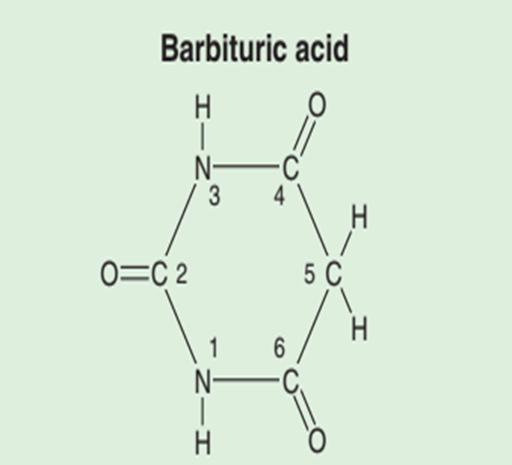
Introduction
Discovered in the early 20th century as hypnotics.
They were the most commonly used IV drugs administered to induce anesthesia prior to the introduction of propofol.
Barbiturates are organic compounds derived from barbituric acid (2,4,6-trioxohexahydropyrimidine); a combination of urea & malonic acid)
Notes:
Barbiturate solutions are highly alkaline, allowing for formation of water-soluble salts. Addition or reconstitution in
acidic solutions (e.g., vecuronium) leads to precipitation of these salts, hampering intravenous use.

Slide 67
Cont.…
Characteristics
Sedative-hypnotics
Amnestic
Anticonvulsant
Water soluble but markedly alkaline
Thus, they can be reconstitution with either water, glucose 5%, or normal saline but not with RL.
Cannot be stored for an extended period of time at room temperature after reconstitution in solvent.
In alkaline solution, thiobarbiturates can be stored up to 2 weeks, and methohexital up to 6 weeks
Notes:
Barbiturates cannot be reconstituted with lactated Ringer solution or mixed with other acidic solutions, as a decrease in the alkalinity of the solution can result in precipitation of the barbiturates as free acids. Examples of drugs that are not to be co-administered or mixed in solution with the barbiturates are atracurium, vecuronium, rocuronium, suxamethonium, alfentanil, sufentanil, dobutamine, dopamine, esketamine, and midazolam. Mixing of thiopental with vecuronium or pancuronium results in the formation of precipitate that may occlude the IV line during a rapid sequence induction of anesthesia

Slide 68
Mechanism of action
Depress the reticular activating system located in the brain stem, which controls multiple vital functions, including consciousness.
they suppress transmission of excitatory neurotransmitters (e.g, glutamate and acetylcholine) and
enhance transmission of inhibitory neurotransmitters (e.g..γ-aminobutyric acid [GABA]).
Specific mechanisms include
interfering with transmitter release (presynaptic) and
stereoselectively interacting with receptors (postsynaptic) produces hypnosis (sedation) with amnesia
Notes:
Reticular activating system—a complex polysynaptic network of neurons and regulatory centers—located in the brain stem that controls several vital functions, including consciousness

Slide 69
Classification
Oxybarbiturates
Barbiturates retaining an oxygen atom on the number 2 carbon of the barbituric acid ring.
Thiobarbiturates
Barbiturates replacing oxygen at C2 with a sulfur atom
Which increases lipid solubility
are more lipid soluble than Oxybarbiturates.

Slide 70
Barbiturates
Thiopentone
Thyiamylal Thiobarbiturates
Methohexital
Secobarbital Oxybarbiturates
Phenobarbital
pentobarbital

Slide 71
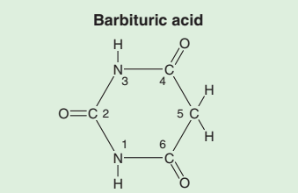
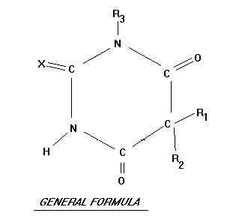
Structure of barbiturates….

Slide 72
Pharmacokinetics of Barbiturates
Absorption
Most frequently administered intravenously for
induction of general anesthesia in adults and children with an intravenous line.
Exceptions include:
rectal thiopental or methohexital has been used for induction in children and
Intramuscular (or oral) pentobarbital or secobarbital was often used for premedication of all age groups.

Slide 73
Pharmacokinetics….
Distribution
The duration of action of highly lipid-soluble barbiturates (thiopental, thiamylal, and methohexital) is determined by
redistribution, not by metabolism or elimination.
For example, although thiopental is highly protein bound (80%), its great lipid solubility and high nonionized fraction (60%) account for rapid brain uptake (within 30 s).
Highly lipid-soluble
Notes:
Redistribution to the peripheral compartment— Specifically, the muscle group—lowers plasma and brain concentration to 10% of peak levels within
20–30 min ( Figure 9–2 ). Th is pharmacokinetic profile correlates with clinical experience—patients typically lose consciousness within 30 s and awaken within 20 min.

Slide 74
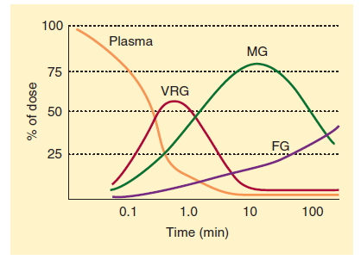
Cont.…
FIGURE 9-2 Distribution of thiopental from plasma to the vessel-rich group (VRG; brain, heart, liver, kidney, endocrine glands), to the muscle group (MG), and finally to the fat group (FG).
Notes:
After delivery of an IV bolus, the percentage of thiopental remaining in blood rapidly decreases as drug moves from blood to body tissues. The time to attainment of peak tissue levels is a direct function of tissue capacity for barbiturate relative to blood flow. A larger capacity or smaller blood flow is related to a longer time to a peak tissue level. Initially, most thiopental is taken up by the vessel-rich group (VRG) of tissues because of their high blood flow. Subsequently, drug is redistributed to muscle and to a lesser extent to fat

Slide 75
Pharmacokinetics….
If central compartment is contracted (hypovolemic shock), or serum albumin is low (severe liver disease or malnutrition), or nonionized fraction is increased (acidosis),
larger brain and heart concentrations will be achieved for a given dose
Induction doses depend on body weight & age
Reduced induction doses are required for elderly patients
primarily due to slower redistribution.

Slide 76
Pharmacokinetics….
Biotransformation
Undergo hepatic oxidation to inactive water-soluble metabolites..
Oxybarbiturates are metabolized only in hepatocytes.
Although redistribution is responsible for the awakening from a single dose of any of these lipid-soluble barbiturates,
full recovery of psychomotor function is more rapid following use of methohexital due to its enhanced metabolism.
Notes:
Because of greater hepatic extraction, methohexital is cleared by the liver more rapidly than thiopental.
Although redistribution is responsible for the awakening from a single sleep dose of any of these lipid-soluble barbiturates, full recovery of psychomotor function is more rapid following methohexital due to its enhanced metabolism.

Slide 77
Pharmacokinetics….
Excretion
Increased protein binding decreases barbiturate glomerular filtration,
where as increased lipid solubility tends to increase renal tubular reabsorption.
Except for the less protein-bound and less lipid-soluble agents such as phenobarbital,
renal excretion is limited to water-soluble end products of hepatic biotransformation.
Methohexital is excreted in the feces.

Slide 78
Pharmacodynamics of barbiturates
Cardiovascular
↓ MAP and Cardiac output
The primary mechanism is reduction of venous vascular tone, followed by
peripheral pooling of venous blood and a decrease in venous return.
↑ HR (tachycardia)
- probably due to a central vagolytic effect and reflex responses to decreases in BP.

Slide 79
Cont.….
Depression of the medullary vasomotor center vasodilates peripheral capacitance vessels,
which increases peripheral pooling of blood and decreases venous return to the right atrium
Cardiac output is maintained by ↑ in HR and myocardial contractility from compensatory baroreceptor reflexes

Slide 80
Cont…
Respiratory
Respiratory depression in a dose-dependent manner
Decreases ventilatory response to hypercapnia and hypoxia
By depressing of medullary ventilatory center
Deep barbiturate sedation often leads to upper airway obstruction; apnea usually follows an induction dose.
Decreases tidal volume and RR during awakening.
Do not completely depress noxious airway reflexes
Bronchospasm or laryngospasm in lightly anesthetized patients with airway manipulation
Notes:
Barbiturates incompletely depress airway reflex responses to laryngoscopy and intubation, and airway instrumentation may lead to
bronchospasm (in asthmatic patients) or laryngospasm in lightly anesthetized patients.
Barbiturates cause respiratory depression in a dose-dependent manner, leading to central apnea at deeper stages of anesthesia.

Slide 81
Cont…
Cerebral
Constrict cerebral vasculature ⇒ ↓es CBF, CBV and ICP
Cerebral perfusion pressure (CPP) usually increased, improved or unchanged
since drop in ICP exceeds decline in arterial blood pressure
CPP = MAP – CVP or ICP
↓ cerebral oxygen consumption (up to 50% of normal)—dose dependent
Some patients complains a taste sensation of onion, garlic, or pizza taste during induction with thiopental.
Does not selectively impair pain perception,
sometimes lowers pain threshold; so, antianalgesic effect

Slide 82
Cont…
Do not produce muscle relaxation
Some induce involuntary skeletal muscle contractions (e.g., methohexital).
Small doses of thiopental control most grand mall seizures (50-100mg IV).
Acute tolerance and physiological dependence on sedative effect develop quickly.
Renal
↓ renal blood flow and GFR in proportion to decrease in BP.

Slide 83
Cont…
Hepatic
Decreases hepatic blood flow
Induces hepatic enzymes
which increases rate of metabolism of some drugs (digoxin)
but may also interfere with biotransformation of other drugs (TCA)
Induction of aminolevulinic acid synthetase
stimulates formation of porphyrin (an intermediary in heme synthesis), which may precipitate acute intermittent porphyria in susceptible individuals

Slide 84
Cont…
Immunological
Rare anaphylactic and anaphylactoid allergic reactions
Sulfur-contained thiobarbiturares (like thiopental) theoretically evoke mast cell histamine release, unlike oxybarbiturates
So, some people may prefer methohexital in asthmatic patients.

Slide 85
Barbiturates: Drug Interactions
Ethanol, opioids, antihistamines, other CNS depressants potentiate sedative effect of barbiturates.
Does chronic alcohol abuse associated with increased thiopental requirements during induction?
NO, It lacks scientific proof.
Notes:
Contrast media, sulfonamides, and other drugs that occupy the same protein-binding sites as thiopental may
displace the barbiturate, increasing the amount of free drug available and potentiating the organ system effects of a given dose.
Barbiturates cannot be reconstituted with lactated Ringer solution or mixed with other acidic solutions, as a decrease in the alkalinity of the solution can result in precipitation of the barbiturates as free acids.

Slide 86
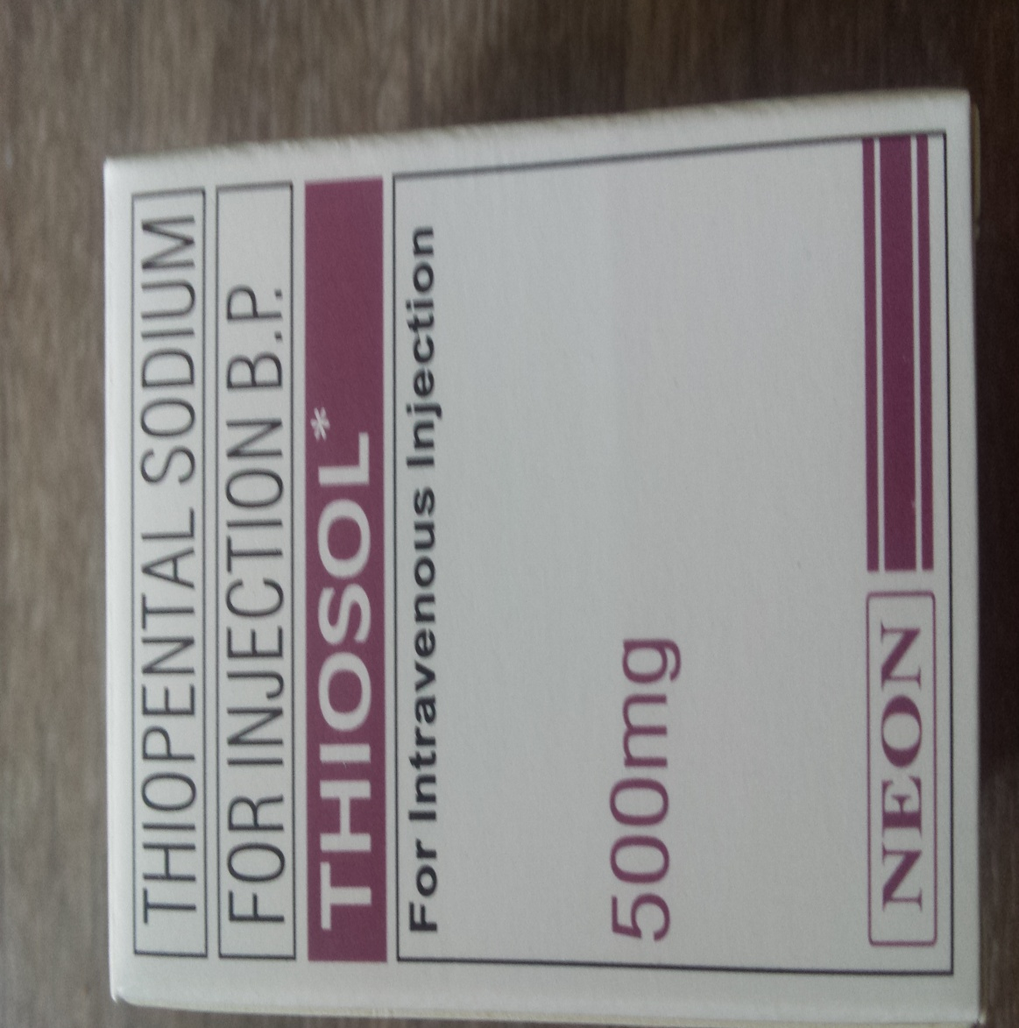
Thiopental

Slide 87
Introduction
Thiopental is one of the earliest IV anesthetics used.
Discovered in the 1930s.
First used on human patients in 1934
It was the “gold standard” for IV anesthetics for 50 years due to
rapid, smooth onset of sedative and hypnotic effects,
Predictable pharmacokinetics, and a rapid and smooth emergence.
However, thiopental has a long context-sensitive half-time that made it less ideal for use as an infusion.
Notes:
Prolongation of early and late recovery by the barbiturates is the primary reason behind the fact that they have been largely replaced by propofol.

Slide 88
Thiopental
It is a yellow hygroscopic powder with a bitter taste
It is dissolved to produce a 2.5% sol. with a PH of 10.5 – 11.
It is an ultra-short acting barbiturate.
Rapid onset (15-30 seconds) and short duration of action.
Consciousness regained within 5-10 minutes by redistribution to skeletal muscle
Longer elimination half time- 12hrs. vs metohexital

Slide 89
Thiopental…
Its high alkalinity makes it irritant to tissues – necrosis.
The necrotizing action increases as the concentration increases
About 70-80% of administered dose – bound to plasma protein
Although thiopental is highly protein bound (80%),
its great lipid solubility and high nonionized fraction (60%) account for maximal brain uptake within 30 sec.

Slide 90
Mechanism of action of thiopental
Involves:
Activation (Enhancement) of GABA receptor complex:
Enhancement of GABA-mediated Cl− currents ↔ leading to hyperpolarization of neurons and reduced excitability
Inhibition of excitatory transmission

Slide 91
Pharmacodynamics
CNS:
barbiturates interact with chloride ion channels by altering the duration they spend in an open state
this facilitates inhibitory neurotransmitters such as gamma amino butyric acid (GABA)
Thiopental will decrease both cerebral electrical & metabolic activity
So it can be used to stop seizures activity in emergency situations

Slide 92
Pharmacodynamics…
Elevated ICP can quickly be reduced by thiopental
but the improvement of ICP requires high dose of thiopental to be maintained
The reduction of ICP is due to
cerebral vasoconstriction,
reduced cerebral metabolism & oxygen requirements associated with decreased cerebral blood volume (CBV)
Thiopental has an anti-analgesic effect, since low dose may decrease pain threshold.

Slide 93
Pharmacodynamics…
CVS
Thiopental causes a dose related
depression of myocardial function as measured by CO, SV, and blood pressure
Venous tone decreases (decreased preload)
Contributes to the increase in HR (10% to 36%) and decrease in BP----reflex tachycardia
Notes:
Mechanisms for the decrease in cardiac output include (1) direct negative inotropic action, due to a decrease of calcium influx into the cells, (2) decreased ventricular filling, due to increased capacitance, and (3) transiently decreased sympathetic outflow from the CNS.

Slide 94
Pharmacodynamics…
Respiratory
Associated with 2 or 3 large breaths followed by apnea for less than 1minute.
Dose related depression of the respiratory response to hypercarbia and hypoxia
However, respiratory depression is shorter vs propofol.
Thus, during the induction of anesthesia with thiopental, ventilation must be assisted or controlled to provide adequate respiratory exchange
Laryngospasm and bronchoconstriction may be associated with
light levels of thiopental and with airway manipulation or intubation
FRC is reduced by 20% with induction of anaesthesia

Slide 95
Pharmacodynamics…
GI
Enzyme induction may occur with prolonged high dose therapy.
Hypoalbuminemia will result in an increase in unbound (free) thiopental and an increase in the potency of thiopental.
GU/pregnancy/fetus:
It has little or no effect on the kidneys or gravid uterus.

Slide 96
Pharmacokinetics
Skeletal muscle- initial redistribution
Fat- rises 30 minutes after injection.
Should be calculated according to lean body mass.
Mostly Hepatic metabolism by:
a) Oxidation
b) Desulfuration
c) Destruction of barbituric acid ring
Inactive metabolites excreted by kidney
Conjugated excreted in bile

Slide 97
Pharmacokinetics…
Chronic administration of barbiturates or other drugs that induce oxidative microsomal enzymes (enzyme induction) ⇒ Enhances barbiturate metabolism
Factors affecting the distribution of thiopentone
Hypovolemia,
Obesity,
Acidosis,
Hypoalbuminemia,
Anxiety
Factors which  Protein binding of thiopental
Uremia, Certain drugs
Hypovolemia – low plasma protein, Acidosis.
Notes:
Obesity has been noted to lower thiopental induction requirement on a per kilogram basis,
but similar to propofol, the use of lean body mass to determine induction dose corrects the difference owing to a decrease in the central volume of distribution.

Slide 98
Thiopentone-
Clinical uses
Induction of anesthesia
The prompt onset (15-30 seconds), smooth induction and rapid emergence are advantages for this drug.
Maintenance of anesthesia for short procedures
It is rarely used as an IV infusion for maintenance of GA because higher doses lead slow plasma clearance.
Control of convulsive states
For supplement of regional anesthesia or low potency anesthesia

Slide 99
Thiopental…
Doses and administration
Administered IV as 2.5 % or 5 % solution.
Induction IV 3-5 mg/kg
Sedation IV 0.5-1.5 mg/kg
Maintenance Infusion (rarely) IV 50-100 mg every 10-12 min

Slide 100
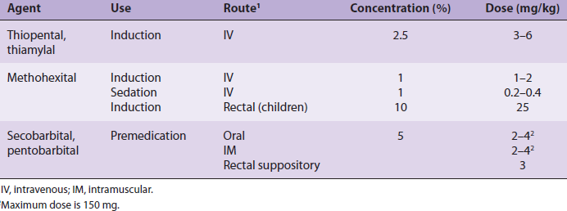
Uses and dosages of common barbiturates.
The three barbiturates that are used most commonly for IV anesthesia induction and maintenance are thiopental, thiamylal, and methohexital.

Slide 101
Side effects of Thiopental
Hypotension :
if thiopental is administered to hypovolemic, shocked or previously hypertensive patient
Respiratory depression :when excessive doses are used
Tissue necrosis(rarely) : following venous infusion
Bronchospasm
Unusual but may be precipitated in asthmatics patients
Garlic or onion taste (40% of patients),
Notes:
Intravenous administration of thiopental is typically not irritating or painful, but if injected outside the vein into subcutaneous tissue, it can cause
discomfort. Methohexital-induced pain on injection is much more prevalent.

Slide 102
Cont.…
Allergic reaction : from cutaneous rashes to severe anaphylactic shock with CVS collapse
Laryngospasm: this may result from
direct stimulation by airway,
laryngoscopy
stimulation of some remote area
Cough, hiccups, tremors, and twitching (rare).
Local tissue irritation or pain
if injected outside the vein into subcutaneous tissue

Slide 103
Cont…
Complications of thiopentone
Skin sloughing
Neuritis
phlebitis
Arterial spasm
Precipitation of solid crystals of thiopentone
block small arteries.
Notes:
Examples of drugs that are not to be coadministered or mixed in solution with the barbiturates are atracurium, vecuronium, rocuronium, suxamethonium, alfentanil, sufentanil, dobutamine, dopamine, esketamine, and midazolam. Mixing of thiopental with vecuronium or pancuronium results in the formation of precipitate that may occlude the IV line during a rapid sequence induction of anesthesia.

Slide 104
Cont…
Rarely, intra-arterial injection can occur.
The consequences of accidental arterial injection may be severe.
The degree of injury is related to the concentration of the drug.
Treatment consists of
dilution of the drug by the administration of saline into the artery,
heparinization to prevent thrombosis, and
brachial plexus block ( for potential arteriodilation).

Slide 105
Cont…
Symptoms and signs of intra-arterial injection
The patient will feel intense pain.
The hand will be very pale or white.
The hand will be cold (arterial spasm).
The hand will be edematous.
The pulse may be absent.

Slide 106
Cont…
Treatment Of Thiopentone Intra-arterial Injection
Leave the needle in the artery
Flush with N/S
inject lignocaine (10mls of 1%) into the artery.
Sympathetic nerve block (stellate ganglion block) – to block SNS nerve supply to arm)
Horner's Syndrome can be manifested.
Full heparinisation may be required
Thrombectomy may be required
Occasionally amputation is needed

Slide 107
Cont.…
Contraindication Of Thiopental I. Absolute
Lack of knowledge of the drug.
Lack of resuscitative equipment.
Inability to maintain a patent airway.
Complete absence of suitable veins.
Allergy or hypersensitivity to barbiturates.
Status asthmaticus.
Porphyria (Variegate Porphyria, or Acute Intermittent Porphyria).
Notes:
Porpyrins are Group of N₂ containing organic compounds that occur in protoplasm (Hemoglobin).=> liver disorder

Slide 108
Contraindication…
II. Relative:
Hypotension or shock.
Severe cardiovascular disease (instability).
Severe liver disease.
Myxedema.
Notes:
when there is respiratory obstruction or an inadequate airway, thiopental may worsen respiratory depression.

Slide 109
Methohexital
It is a methylated oxybarbiturate
It is used in 1 % solution: 1 to 2 mg/ kg/ IV
Drug of choice for providing anesthesia during electroconvulsive therapy (ECT).
The only IV barbiturate which can compete with thiopental for induction
May be preferred than thiopental for maintenance
because it cleared more rapidly than thiopental

Slide 110
Cont.…
Shorter elimination half time- 2- 4 hrs. vs thiopental.
Less irritating to tissues
Cause less CVS depression
Can cause seizure (large dose)
Abnormal muscular movements with tremor
Cause abnormal spike discharges in epileptic subjects

Slide 111
Cont…
Doses of Methohexital
Induction IV 1-2mg/kg
Sedation IV 0.2-0.4 mg/kg
Induction Rectal 25 mg/kg

Slide 112
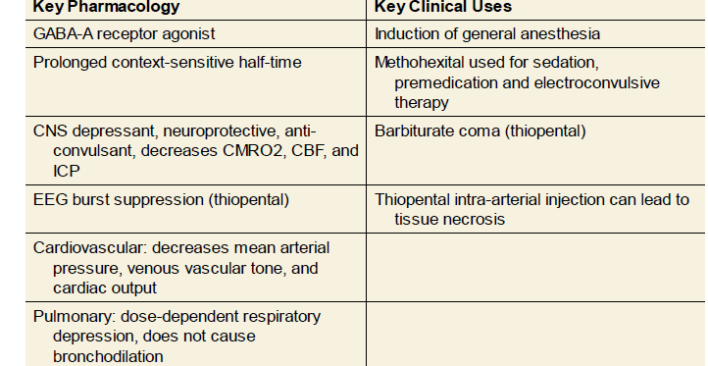
Summary of barbiturates

Slide 113
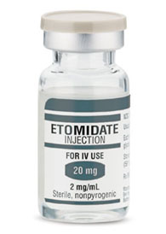
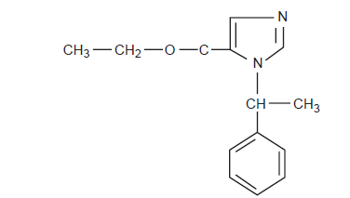
Etomidate
Structure of etomidate, an imidazole derivative

Slide 114
Etomidate
Introduced in 1972 as an induction agent
Hypnotic, but not analgesic
Minimal cardiovascular effects
Concentration—0.2 % (2mg/ml); PH = 6.9
Hydrophobic at physiologic pH
Appearance—clear liquid
It has large safety margin

Slide 115
Cont.…
Mechanisms of Action
Etomidate depresses the reticular activating system and mimics the inhibitory effects of GABA.
i.e., GABA-A receptor agonist

Slide 116
Cont.…
Structure–Activity Relationships
Etomidate contains a carboxylated imidazole and is structurally unrelated to other anesthetic agents.
The imidazole ring provides water solubility in acidic solutions and lipid solubility at physiological pH.
Therefore, it is dissolved in propylene glycol for injection.
This solution often causes pain on injection that can be lessened by a prior intravenous injection of lidocaine.

Slide 117
Pharmacokinetics of etomidate
Absorption
It is available only for IV administration
It is used primarily for induction of general anesthesia.
Distribution
Although it is highly protein bound (75%),
It has rapid onset due to
its high lipid solubility and large nonionized fraction at physiological pH.
Quick recovery due to redistribution to inactive sites
Notes:
Etomidate is largely protein bound (approximately 75%) and thus affected by pathologic conditions and/or drugs that alter serum proteins.

Slide 118
Cont.…
Biotransformation
Metabolized by ester hydrolysis (plasma esterases) to inactive metabolites
Excretion
The end products of etomidate hydrolysis are primarily excreted in the urine.
excreted by the kidney (80%) and in bile (20%).
Short context-sensitive half-time
but not usually given as an infusion due to endocrine response

Slide 119
Pharmacodynamics of Etomidate
CNS
Potent Cerebral vasoconstrictor ( ↓ CBF, ↓ CBV, ↓ ICP, ↓ CMRO2)
Spontaneous myoclonic activity (50% of patients)
CPP is either maintained or increased.
because it has minimal effect on the MAP

Slide 120
Pharmacodynamics…
CVS
It has minimal effects on the CVS
modest ↓ in BP,
minimal effect on HR and CO
minimal effect on the MAP
does not release histamine.
Respiratory
Less depression than thiopental /propofol or benzodiazepines
Even induction doses usually do not result in apnea unless opioids have also been administered.

Slide 121
Pharmacodynamics…
Endocrine
Adrenocortical suppression
Induction doses transiently inhibit enzymes involved in cortisol and aldosterone synthesis (11β-hydroxylase).
Long-term infusions lead to adrenocortical suppression
associated with an increased mortality rate in critically ill (septic) patients.
Consider treating with steroids if unexplained hypotension develops.
Notes:
11-beta-hydroxylase is responsible for the conversion of cholesterol to cortisol.

Slide 122
Cont.…
Clinical Uses
Hemodynamically stable induction
for cardiac, trauma, and hypovolemic patients
Choice for MAC sedation because of
the preservation of airway reflexes.

Slide 123
Etomidate: dose
Induction of anesthesia
Dose=0.2-0.3 mg / kg IV
Good for those patients with compromised myocardial contractility (heart failure)

Slide 124
Cont.…
Advantages
Minimal CV effect vs. propofol and thiopental
Rapid onset
Quick recovery ----3-8 minutes

Slide 125
Cont.…
Side effects
Adrenocortical suppression
No analgesia vs. ketamine
Pain on injection
Postoperative nausea and vomiting (PONV)
Hiccups
Myoclonic movements during induction
It may have disinhibitory effects on the parts of the CNS that control extrapyramidal motor activity.

Slide 126
Cont.…
Drug Interactions
Fentanyl increases the plasma level and prolongs the elimination half-life of etomidate.
Opioids decrease the myoclonus characteristic of an etomidate induction.

Slide 127
Dexmedetomidine
Introduced into clinical practice in 1999.
It is an alpha-2-adrenergic agonist.
It has analgesic properties, and can reduce opiate requirements in ICU patients
It is a sedative
which has limited respiratory depressant effects

Slide 128
Pharmacokinetics of Dexmedetomidine
Rapid distribution phase with
Distribution half-life of 6 minutes;
a terminal elimination half life of 2 hours
Highly protein binding ( 94%)
Undergoes almost complete biotransformation with very little unchanged dexmedetomidine in the urine and feces.

Slide 129
Pharmacodynamics of Dexmedetomidine
Acts on the alpha-2-adrenergic receptors in the spinal cord and brain.
Its effects are primarily at the locus coeruleus that activates sleep centers in the brain.
Clinically, patients are sedated but
easily arousable, and
able to follow commands with minimal respiratory depression
↓ HR (Bradycardia)
↓ BP (Hypotension)

Slide 130
Cont.…
Clinical uses
ICU sedation in mechanically ventilated patients
Procedural sedation
As a component of general anesthesia
Pediatrics: preoperative anxiolysis and emergence delirium
Local anesthesia adjuvant
It was found to prolong both motor and sensory blocks when administered intrathecally in combination with local anesthetic.

Slide 131
Cont.…
DOSE
Administration: IV bolus: 0.5–1 mcg/kg over 15 min,
followed by 0.3–0.7 mcg/kg/h IV infusion

Slide 132
Cont.…
Side Effects
Hypotension (23%)
Bradycardia (40%)
can be managed with
atropine, ephedrine, or volume administration
Dry mouth
Nausea

Slide 133
Benzodiazepines (BZDs)
Diazepam
Midazolam
Lorazepam

Slide 134
Outline
Pharmacokinetics BZDs
Pharmacodynamics BZDs
MOAs of different classes of commonly used BZDs

Slide 135
Introduction
Benzodiazepines were discovered in 1954 by Sternbach.
Chlordiazepoxide (Librium) was the first benzodiazepine patented in 1959.
Widely used in anesthesia as
anxiolytics,
sedatives, and
hypnotics.

Slide 136
Benzodiazepines: Mechanism of Action
Interact with specific cerebral cortex receptors
Benzodiazepine-receptor binding facilitates GABA receptor binding, ↑es membrane conductance of Cl- ions
Causes change in membrane polarization and inhibits normal neuronal function

Slide 137
Cont…
They inhibit the actions of glycine by
increasing the concentration of a glycine inhibitory neurotransmitter ⇒ which will lead to antianxiety and skeletal muscle relaxant effects.
Facilitate the actions of the inhibitory neurotransmitter GABA
which results in the sedative and anticonvulsant effects.

Slide 138
Cont.…
Characteristics
Anxiolytic
Anterograde amnestic-----retrograde memory is not affected
Sedative
Hypnotic
Muscle relaxant (centrally produced)
Anticonvulsants.

Slide 139
Cont.…
Anaesthetic Uses
Premedication - diazepam, lorazepam
IV Sedation - diazepam, midazolam
Anticonvulsant - diazepam
Induction of anaesthesia - midazolam
Maintenance of anaesthesia
suppression of seizure activity
Nausea and Vomiting Prophylaxis - IV midazolam

Slide 140
Pharmacokinetics Of BZDs
Absorption:
Commonly administered PO, IM, and IV to provide sedation
or, less commonly, to induce general anesthesia
Diazepam and lorazepam are well absorbed from GIT,
with peak plasma levels in 1 and 2 hrs., respectively.
Oral midazolam is popular for pediatrics premedication.
IM diazepam is painful and unreliable.
Midazolam and lorazepam are well absorbed after IM, with peak levels in 30 and 90 minutes, respectively.

Slide 141
Cont.…
Distribution
Very highly protein bound (90-98%).
Diazepam:
Very lipid soluble, rapidly penetrates blood-brain barrier
Lorazepam:
moderate lipid solubility, slower brain uptake and onset of action
Midazolam:
Water soluble at low pH, structural component causes increase in its lipid solubility
Redistribution is fairly rapid and is responsible for awakening.
Frequently used as induction agent
But none can match rapid onset or short duration of propofol or thiopental

Slide 142
Cont.…
Biotransformation
Rely on the liver for biotransformation into water-soluble glucuronide end products.
The phase I metabolites of diazepam are pharmacologically active.
Slow hepatic extraction and a large V_{d} result in a long elimination half-life for diazepam (30 hr).
Although lorazepam also has a low hepatic extraction ratio,
its lower lipid solubility limits its V_{d}, resulting in a shorter elimination half-life (15 hr).
Nonetheless, the clinical duration of lorazepam is often quite prolonged due to a very high receptor affinity.
In contrast, midazolam shares diazepam's V_{d}, but its elimination half-life (2 h) is the shortest of the group
because of its high hepatic extraction ratio.

Slide 143
Cont.…
Excretion
The metabolites of benzodiazepines biotransformation are excreted chiefly in the urine.
Enterohepatic circulation produces a secondary peak in diazepam plasma concentration 6–12 h following administration.
Renal failure may lead to prolonged sedation in patients receiving midazolam
due to the accumulation of a conjugated metabolite (α-hydroxymidazolam).

Slide 144
Benzodiazepine Metabolism and Clearance
Drug | Duration | Metabolites | Hepatic Clearance
Midazolam | Short | 1-hydroxymidazolam (mild CNS depressant) | High
Diazepam | Intermediate | Oxazepam and Desmethyldiazepam (Active metabolites) | Slow
Lorazepam | Long | Inactive | Intermediate

Slide 145
Effects on organ systems: Pharmacodynamics
CVS :
Minimal CV depressant effects even at induction doses.
↓ arterial Bp, cardiac output, PVR slightly.
HR sometimes rises
Changes in HR variability during midazolam sedation suggest drug induced vagolysis.

Slide 146
Cont.…
Respiratory
Depress ventilatory response to CO2
Usually insignificant unless drugs given IV or with other respiratory depressants.
Ventilation must be monitored in all patients receiving IV BZDs and resuscitation equipment immediately available.
Tolerance :- addiction liability is less.

Slide 147
Cont.…
Cerebral
↓ CMRO2, ↓ CBF, and ↓ ICP
but not to same extent as barbiturates
Effective in preventing and controlling grand mal seizures
Antegrade amnesia with oral sedative doses.
Mild- muscle-relaxant property
mediated at spinal cord level (not at neuromuscular junction)
Anxiolytic, amnestic, sedative effects seen at low doses progress to unconsciousness at induction doses
Slower loss of consciousness and longer recovery vs thiopental or propofol
Lack analgesic properties

Slide 148
Benzodiazepine: Drug Interactions
Cimetidine binds to cytochrome P-450
reduces metabolism of diazepam
Erythromycin inhibits metabolism of midazolam
causes 2-3x prolongation and intensification of its effects
Heparin displaces diazepam from protein-binding sites
↑es free drug concentration (200% ↑after 1000 units of heparin)
Combination of opioids and diazepam reduce BP and PVR,
Especially pronounced in pts. with ischemic or VHD
Reduce MAC of volatile anesthetics up to 30%.
Ethanol, barbiturates, other CNS system depressants
potentiate sedative effects of benzodiazepines

Slide 149
Cont.…
Side Effects
Associated with limited adverse events.
Hypotension in hypovolemic patients
Respiratory depression—particularly when combined with opioids (synergistic reaction)
Anaphylaxis (extremely rare)
Pain or thrombophlebitis following IV injection, especially diazepam

Slide 150
Diazepam
It was synthesized in 1963 and it was used intravenously to induce anesthesia in 1965.
It is available in oral & intravenous forms
Intermediate duration of action (15-30 min).
Highly protein bound (98%).
Slow hepatic clearance
Long elimination half life (20-50 hr.)
High oral bioavailability (94%)
Very lipid soluble, rapidly penetrates blood-brain barrier
Notes:
Hepatic clearence is the rate of elimination of a drug as a result of liver biotransformation.
The fraction of drug removed from the blood by the liver (hepatic extraction ratio).

Slide 151
Cont.…
IV diazepam use ↓_{ed} because of the advent of midazolam.
Insoluble in water,
so parenteral preparations contain propylene glycol, which can produce venous irritation
Dilution with water causes cloudiness.
IV or IM injection is painful & thrombophlebitis
propylene glycol
Pain on injection can be minimized by dilution & use of large veins

Slide 152
Cont.…
Clinical Uses
Premedication
The goals of this application are anxiolysis, sedation, amnesia, vagolysis, and sympathicolysis, and reduction of PONV.
For induction of anaesthesia for risk pts.
Sedation during regional anaesthesia
To reduce hallucination after Ketamine & control post-operative restlessness.
Anticonvulsant.
For skeletal muscle relaxation.

Slide 153
Dose
Diazepam
Premedication Oral 0.2-0.5 mg/kg
Sedation IV 0.04-0.2 mg/kg
Induction IV 0.3-0.6 mg/kg

Slide 154
Midazolam
First discovered in 1976.
It is the most widely used BZDs in the perioperative period.
Faster onset of action after IV administration
peak effect reached within 2 to 3 minutes
Shorter duration of action (15-20 min) vs. diazepam.
High hepatic clearance
High protein binding: 94% to 98%.
Short elimination half-life (1.8-2.6 hr.) vs. diazepam
Minimal side-effect
It is 3 to 6 times as potent as diazepam
Notes:
Midazolam’s use as a premedication and anesthetic is largely due to its quick onset, short elimination half-life, anterograde amnestic effect, and minimal side-effect profile

Slide 155
Cont.…
Low oral bioavailability (less than 50%)
due to a significant first-pass metabolism in the intestinal wall and the liver
No pain on injection
May cause burning with injection secondary to its acidic formulation
Water-soluble and undergoes conformational change in the bloodstream, becoming more lipophilic
I.e., Its solubility is PH dependent
When exposed to physiologic P_{H ⇒} ↑ lipid Solubility.
Notes:
The pharmacokinetics of midazolam are affected by obesity, age, hepatic cirrhosis, and severity of critical illness. Because of its high lipophilicity (at physiological pH), midazolam distributes preferably to adipose tissue resulting in a prolonged elimination half-life in obese patients. Liver cirrhosis reduces plasma clearance of midazolam due to decreased metabolism.

Slide 156
Cont.…
Route of administration
IV, intranasally, orally, rectally, and intramuscularly.
This flexibility in route of administration also contributes to its popularity.
Its high lipid solubility, short duration of action, and short context sensitive half-time
allow this drug to be administered as a continuous infusion, unlike other benzodiazepines
It is the benzodiazepine of choice for induction of anesthesia.

Slide 157
Cont.…
Midazolam indication
Conscious sedation
Minimally depressed level of consciousness
Independently and continuously maintain an airway and adequate cardiorespiratory function.
Respond to tactile stimulation and/or verbal command.
Tolerate the unpleasant procedures.
Premedication – 0.07 – 0.1mg/kg IM 30-60 min preoperatively.
Induction of anesthesia
IV Infusion in the ICU: 0.02 – 0.1 mg/kg/hr.

Slide 158
Cont…
Drugs that inhibit the metabolism of midazolam
* Cimetidine
* Ranitidine
* Omeprazole
* Oral contraceptives
Drug that enhance the metabolism of midazolam
* Rifampin

Slide 159
Midazolam vs. diazepam
Midazolam is 2-3 times more potent than diazepam:
The dose for IV conscious sedation: 0.5 – 3 mg for midazolam, and 1-10 mg for diazepam.
Midazolam has a more rapid onset, greater amnestic effect, less postoperative sedative effects than diazepam.

Slide 160
Cont…
Pain on injection and subsequent thrombophlebitis is less likely with midazolam
Midazolam is more costly than diazepam.
Midazolam’s duration of action is less than diazepam
Midazolam is supplied as a clear liquid

Slide 161
Midazolam uses and dose
Uses | Route | Dose
Premedication: (anxiolysis/anterograde amnesia) | IM | 0.07-0.1 mg/kg
 | PO | 0.4– 0.8 mg/kg
Sedation | IV | 0.01-0.1 mg/kg
Induction | IV | 0.1-0.4 mg/kg
Infusion (in conjunction with volatile anesthetics): (hypnosis/amnesia) | IV | 0.25–1 mcg/kg/min

Slide 162
Lorazepam
It is mostly used when a prolonged and intense anxiolysis is pursued, like in cardiac surgery.
Typically, 2 to 4 mg is administered orally 2 hours before anesthesia and surgery.
Moderate lipid solubility,
slower brain uptake and onset of action
Long duration of action (60 -120 min)
Highly protein bound (98%)

Slide 163
Cont.…
Inactive metabolites
Intermediate hepatic clearance
It is not soluble in water
It often cause vein irritation due to
the propylene glycol admixture
Unpredictable duration of amnesia
this is undesirable in patients who wish or need to have recall in the immediate postoperative period

Slide 164
Lorazepam uses and dose
Uses | Route | Dose
Premedication | PO | 0.05 mg/kg
 | IM | 0.03-0.05 mg/kg
Sedation | IV | 0.03-0.04 mg/kg

Slide 165
Remimazolam
It is a new benzodiazepine with a structure and onset time similar to midazolam
It has a rapid offset
It has quick onset and offset
offer the potential for use as an infusion.
Undergoes organ-independent metabolism by tissue esterases (similar to remifentanil), and
Thus, does not result in accumulation of drug.
It is reversible with flumazenil
It may be a better choice for procedural sedation than midazolam.

Slide 166
Cont.…
Clinical uses of remimazolam
Procedural sedation (such as colonoscopy)
ICU sedation
as many critically ill patients have end organ dysfunction and would benefit from its organ-independent metabolism
Provides a sedation alternative to propofol
by avoiding PRIS and accumulation of drug leading to prolonged sedation
Resulted in an improved procedure success rate, a reduction in the need for rescue medication, a decrease in time to recovery and a better cognitive recovery Vs. Midazolam

Slide 167
Cont.…
Remiazolam has also been compared to propofol for the maintenance of general anesthesia.
Time to loss of consciousness was slightly longer for remimazolam when compared to propofol.
The incidence of hypotension and the need for vasopressor support was lower in patients who received remimazolam compared to propofol
Further studies are needed to define its clinical uses

Slide 168
BZD antagonist (Antidote)
Flumazenil
is a specific and competitive antagonist of benzodiazepines at benzodiazepine receptors
has little intrinsic activity (practically no effect on normal subjects) but competes with agonists
Flumazenil = specific benzodiazepine antagonist
effectively reverses most of CNS effect of benzodiazepine.
Gives 45-90 min of antagonism
the CNS actions of BZDs antagonized within 2 min following the intravenous administration of flumazenil.
BZD overdose can be reversed by Physiostigmine – nonspecific antagonist

Slide 169
BZD antagonist…
Dosage
0.2 mg per min IV until reaching the desired degree of reversal (up to 3 mg).
The usual total dose is 0.6–1. mg
Because of flumazenil's rapid hepatic clearance and short elimination half-life,
repeat doses may be required after 1–2 h to avoid resedation and premature recovery room or outpatient discharge.
A continuous infusion (0.5 mg/h) may be helpful in the case of an overdose of a longer-acting benzodiazepine.
Liver failure prolongs the clearance of flumazenil and benzodiazepines.

Slide 170
BZD antagonist…
Side Effects & Drug Interactions of flumazenil
Anxiety reactions
in previously sedated patients and symptoms of withdrawal in those on long-term benzodiazepine therapy.
↑ ICP in pts. with head injuries and abnormal intracranial compliance.
May induce seizure activity if
BZDs have been given as anticonvulsants or in conjunction with an overdose of tricyclic antidepressants.
↑ the incidence of emergence dysphoria and hallucinations.
following a midazolam–ketamine anesthetic technique
Nausea and vomiting
Flumazenil does not affect the MAC of inhalation anesthetics.

Slide 171
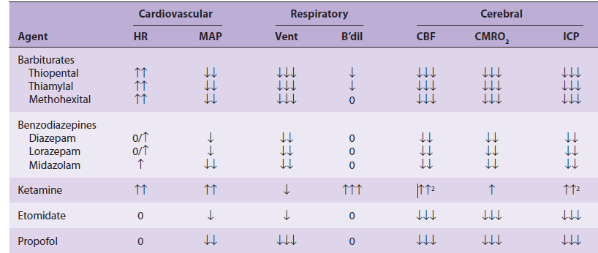
Summary of IV anesthetic effects on organ systems
B’dil = bronchodilation

Slide 172
Cont.…
???

Slide 173
Thank you

